Slide 1
BRITISH AIRWAYS WEB SCRAPING TO GAIN INSIGHT
AMADI DOMINIC UCHECHI
15/5/2024

Slide 2
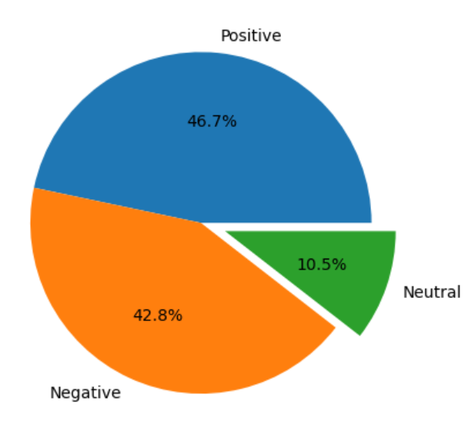
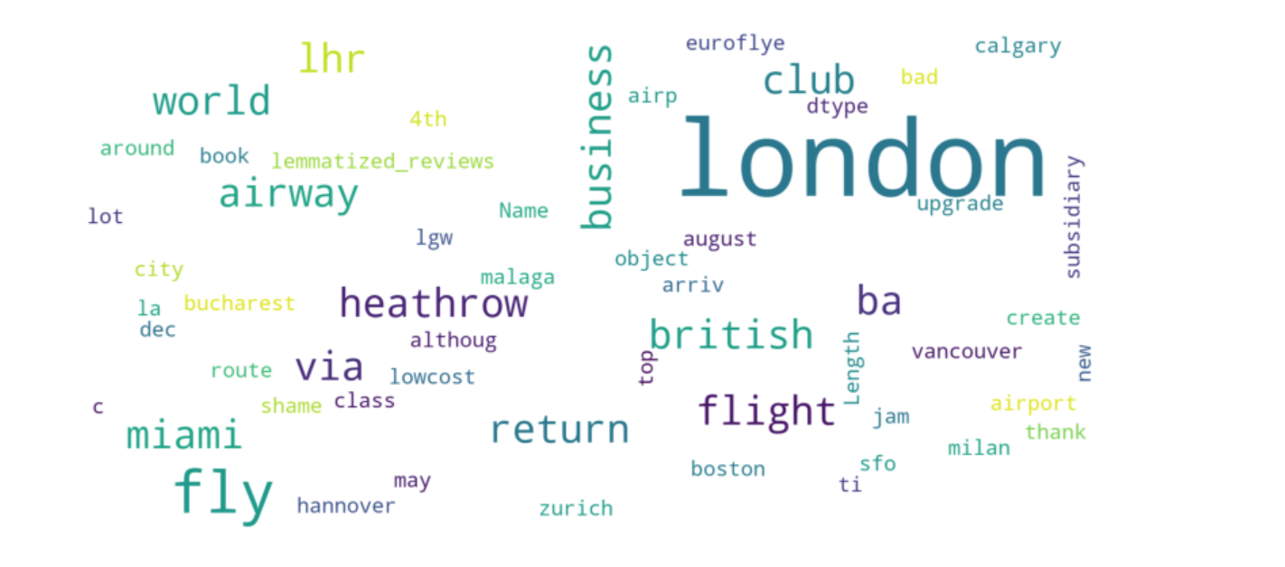
INSIGHTS FROM CUSTOMER REVIEW
SENTIMENT COUNTS REVIEWS
POSITIVE REVIEWS = 467
NEGATIVE REVIEWS = 428
NEUTRAL REVIEWS = 105

